Slide 1
Journey
Map
Mohammad Aadil Sehrawat (INMSZ8)
Associate Data Engineer

Slide 2
Timeline
Data Warehouse
OLAP & OLTP
30th Aug
Case Work
28th Aug
Business Intelligence
29th Aug
SQL Aggregation
31st Aug
Azure SQL
1st Sept

Slide 3
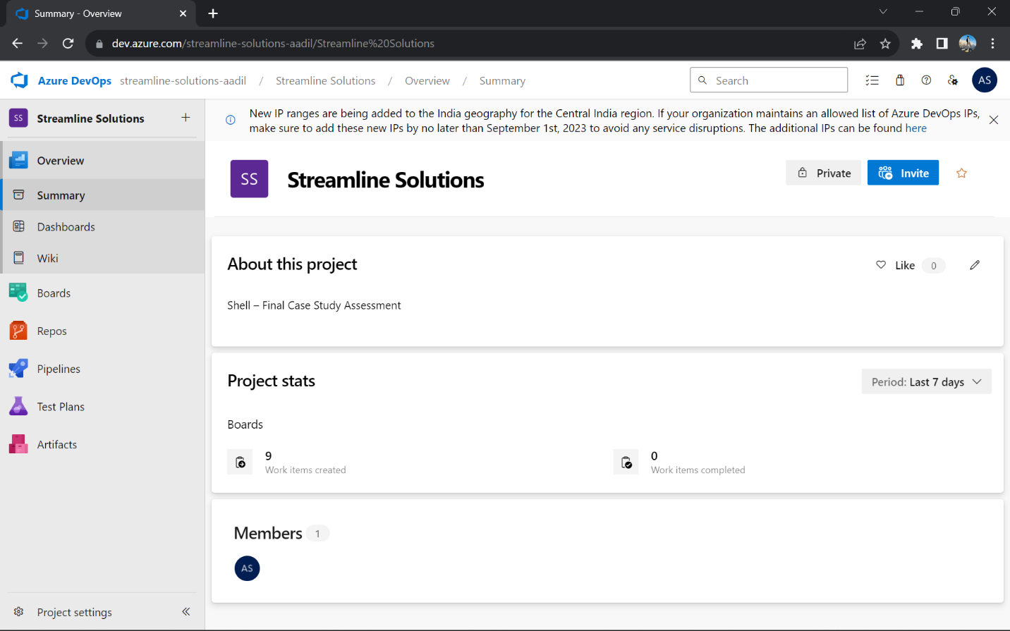
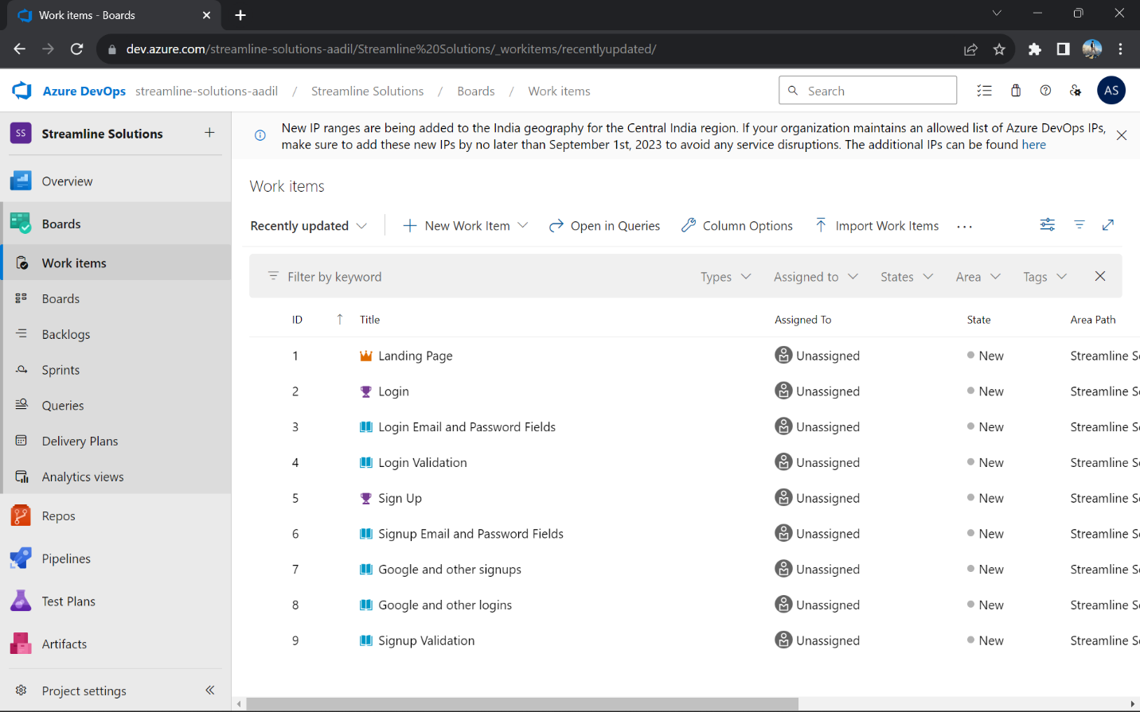
Case Work (28/08/2023)
Carried out a case study that involving implementing a complete CI/CD workflow for a Spring-Boot application
Used Azure DevOps, GitHub, GitHub Actions, Maven, Docker, Azure WebApp, Azure VM, Prometheus
Azure DevOps

Slide 4
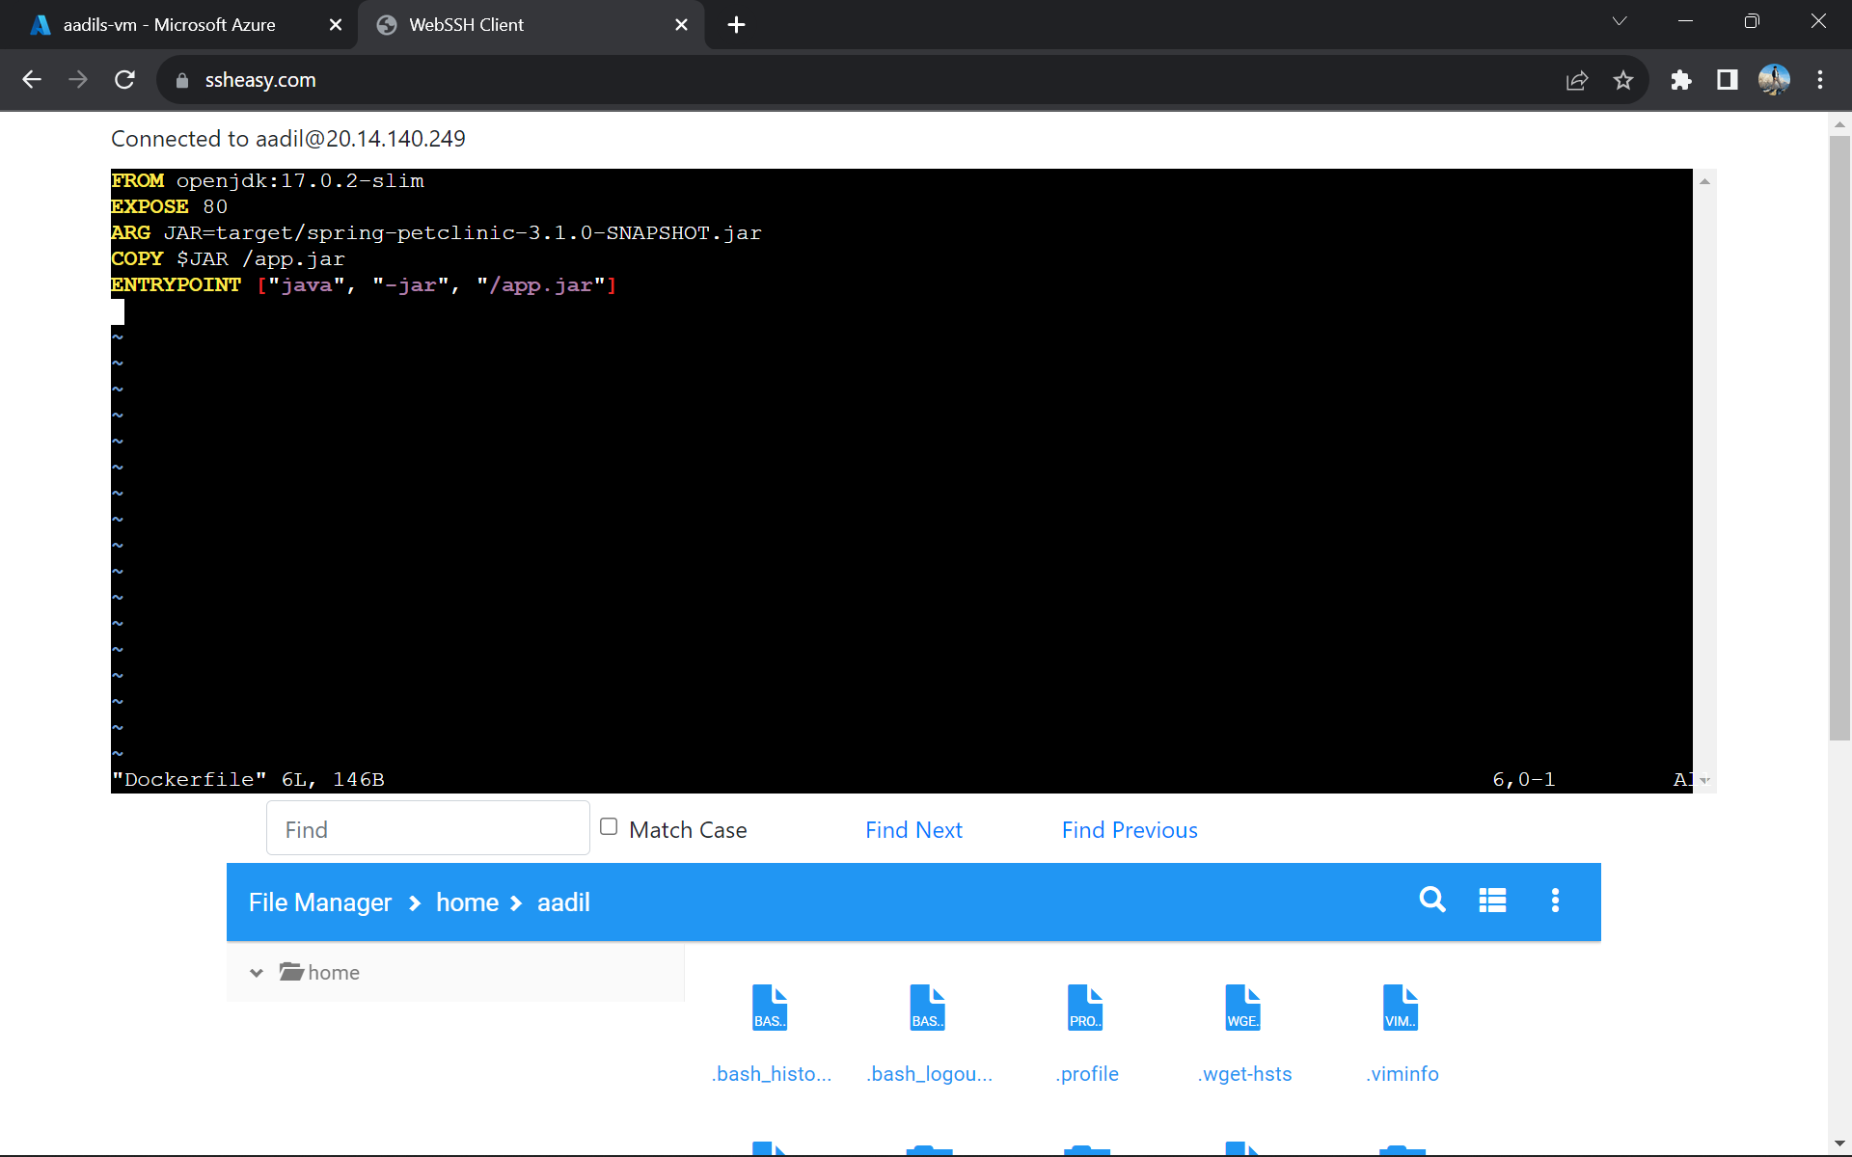
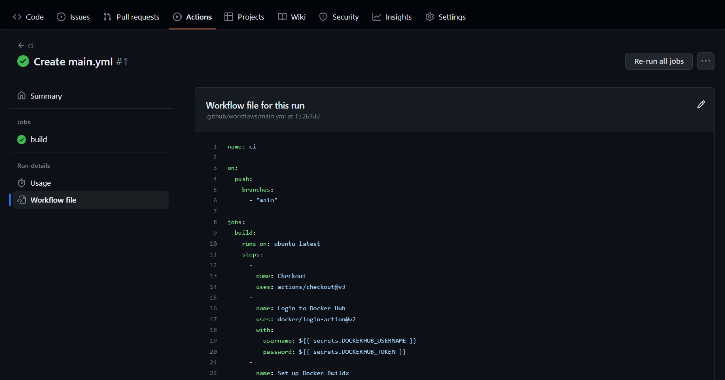
Creating Dockerfile on Azure VM
Github Actions yml file

Slide 5
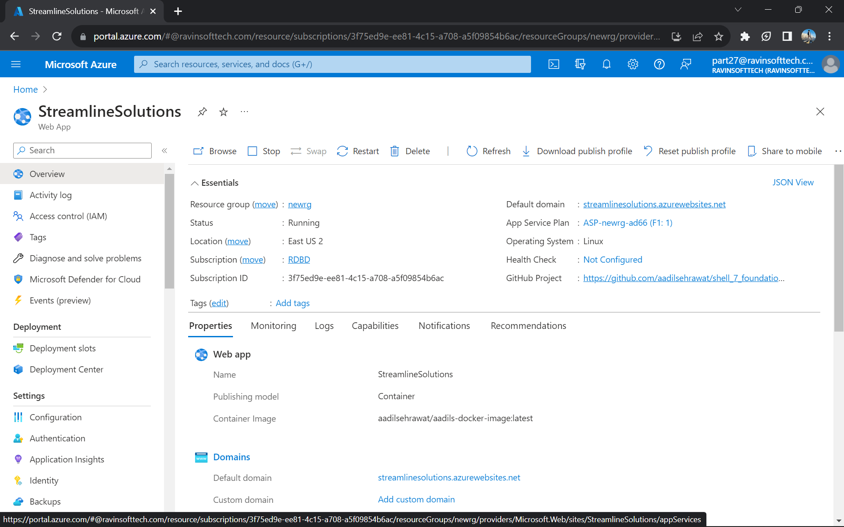
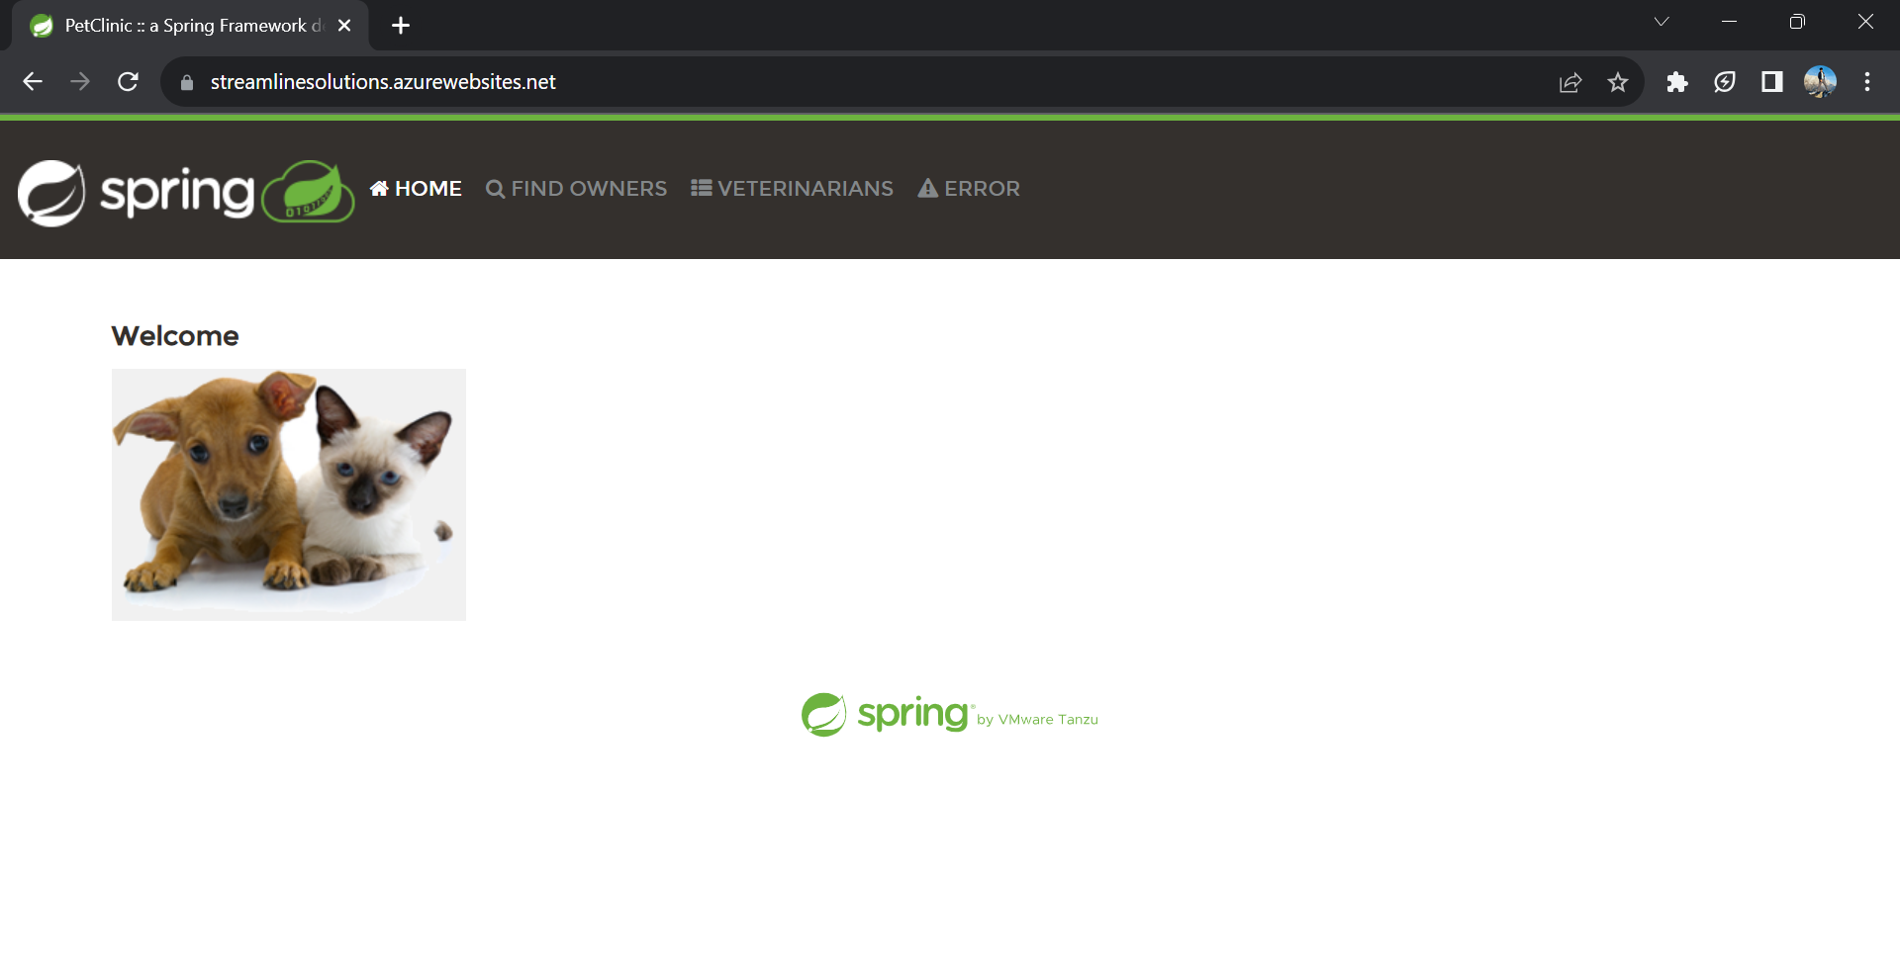
Azure Web App Deployed
App Deployed

Slide 6
Business Intelligence (29/08/2023)
Key learnings –
Introduction to analytics and its importance
Introduction to data warehouse
RDBMS
Normalization
Joins
Cardinality
Dimensional modelling
Data mining

Slide 7
Data Warehouse & Data Lakes (30/08/2023)
Key learnings –
Data Warehouse - relational database that is designed for query and analysis rather than transaction processing.
Data Lakes - a system or repository that stores large amounts of data in its natural form
Star, Galaxy and Snowflake schemas
Sorting, filtering in SQL
OLAP and OLTP - two types of online processing systems that help turn data into information
OLTP is optimized for executing online database transactions
OLAP is optimized for conducting complex data analysis

Slide 8
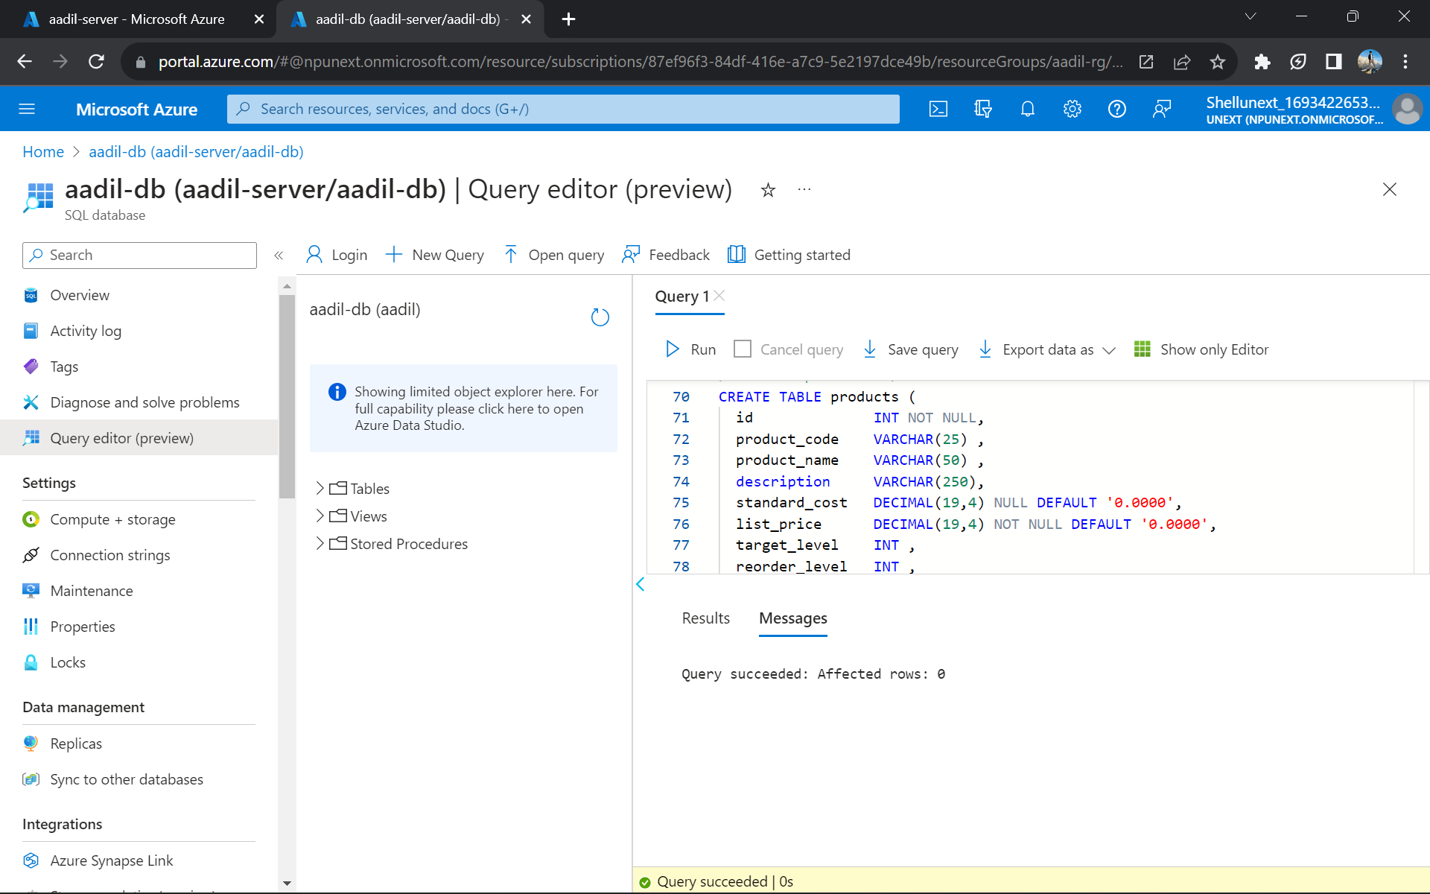
Aggregation (31/08/2023)
Key learnings –
Hands-on on Azure SQL Database
Executed queries on the azure sql database
SQL Aggregation statements –
1. MIN 2. MAX
3. SUM 4. AVG

Slide 9
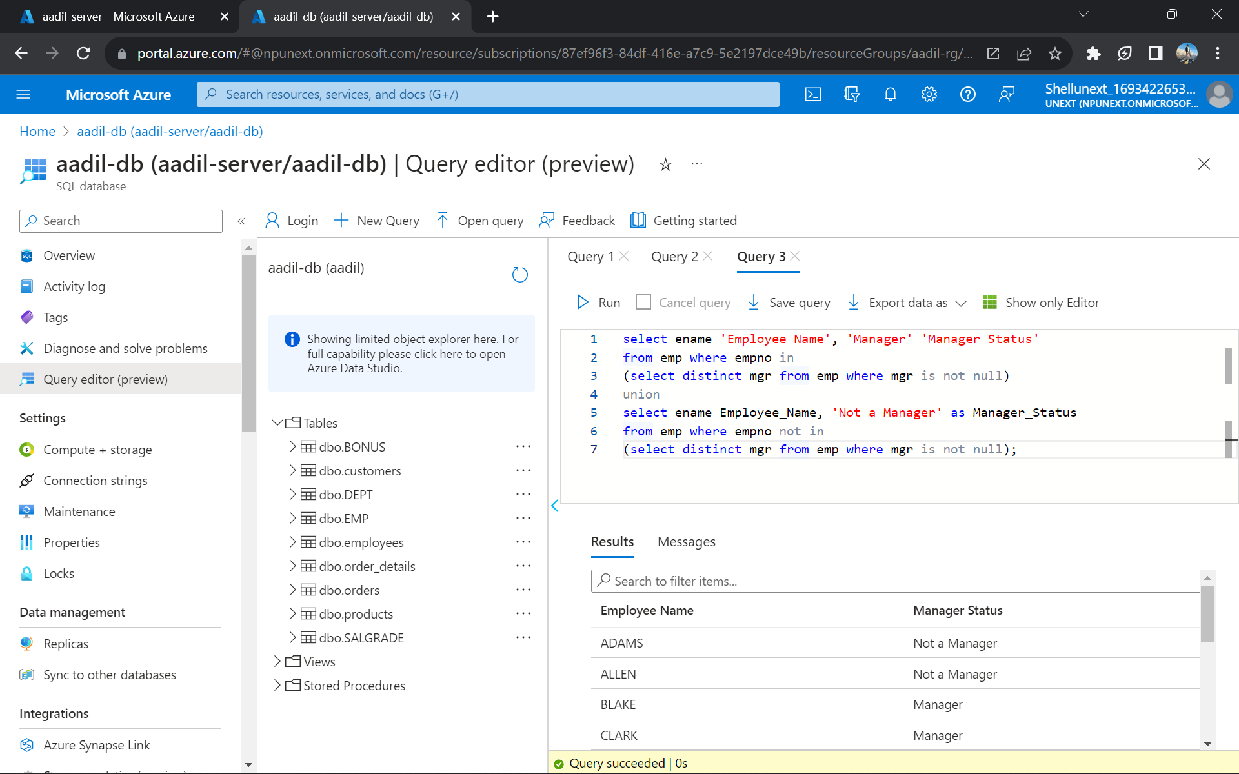
Azure SQL (01/09/2023)
Key learnings –
Inner join, outer join on Azure SQL
Corelated nested queries
Chasm and Fan Traps – in a DB
UNION, INTERSECTION

Slide 10
Thank You!

